Slide 1

Basics of Semiconductors
By Saurav Thakur
(Btech EE)

Slide 2
Semiconductor Materials
Semiconductors are of 2 types elemental and compounds semiconductors
Elemental consists of just one element of group 4 while compound has a group 4 element and elements near metalloid staircase like group 5 or 3 or both are too present.
The elemental is used for making transistors and diodes while compound are used in LEDs or even adding flexibility in the materials
Doping is controlled addition of impurities in order to alter the conductivity and the charge carrier properties
Energy band gap is difference of energy between conduction band and valence band

Slide 3
Miller Indices
(0,0,1)
z
Calculating for a plane
y
(0,3,0)
Find intercepts along axes – 2, 3, 1
Take reciprocal
Convert to smallest integers in the same ratio – 3, 2, 6
Enclose in parenthesis – (3,2,6)
(2,0,0)
x
Equivalent planes are collectively represented in{h,k,l} like for a square {1,0,0}
For vectors their ratio of direction cosines are used to represent their Miller indices [h,k,l] like a diagonal of a square has [1,0,0]

Slide 4
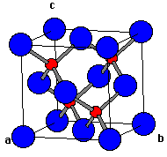
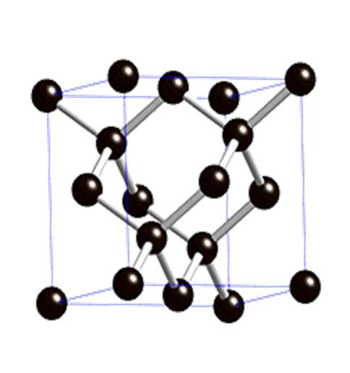
Diamond Lattice
Carbon atoms form fcc and fill all the tetrahedral voids in the lattice. The structure is also known as interpenetrating fcc
It has inferior packing fraction (nearly 34%) as compared to fcc (74%)
Zinc blende structure or Wurtzite structure has alternate tetrahedral voids occupied by zinc and sulphur makes fcc sublattice
Image source– wikimedia.org

Slide 5
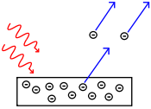
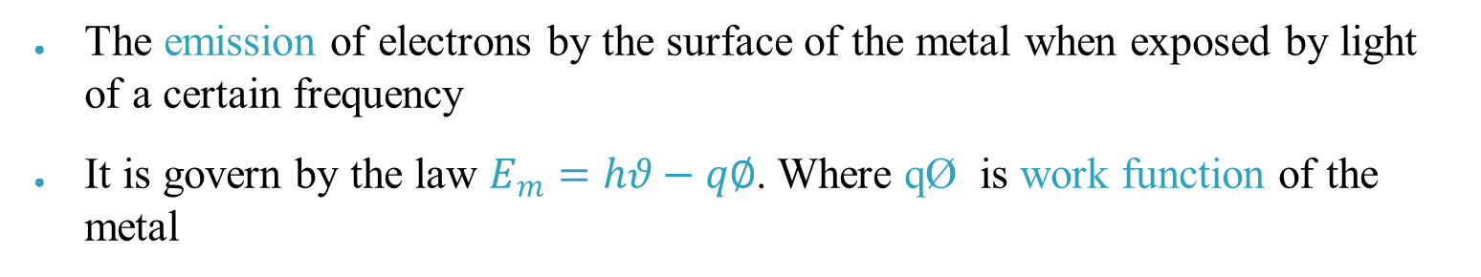
Atomic Theory and Quantum Mechanics
Photoelectric Effect
The emission of electrons by the surface of the metal when exposed by light of a certain frequency
It is govern by the law $E_{m}=hθ−q∅$. Where qØ is work function of the metal
Atomic Spectra
The emission of light due to transition of electron from higher energy orbital to a lower energy orbital
It is govern by the Bohr’s model of the atom which is based on existence of quantified energy states in the atom and hence the transition create the light of wavelength corresponding to the energy difference of the orbitals

Slide 6
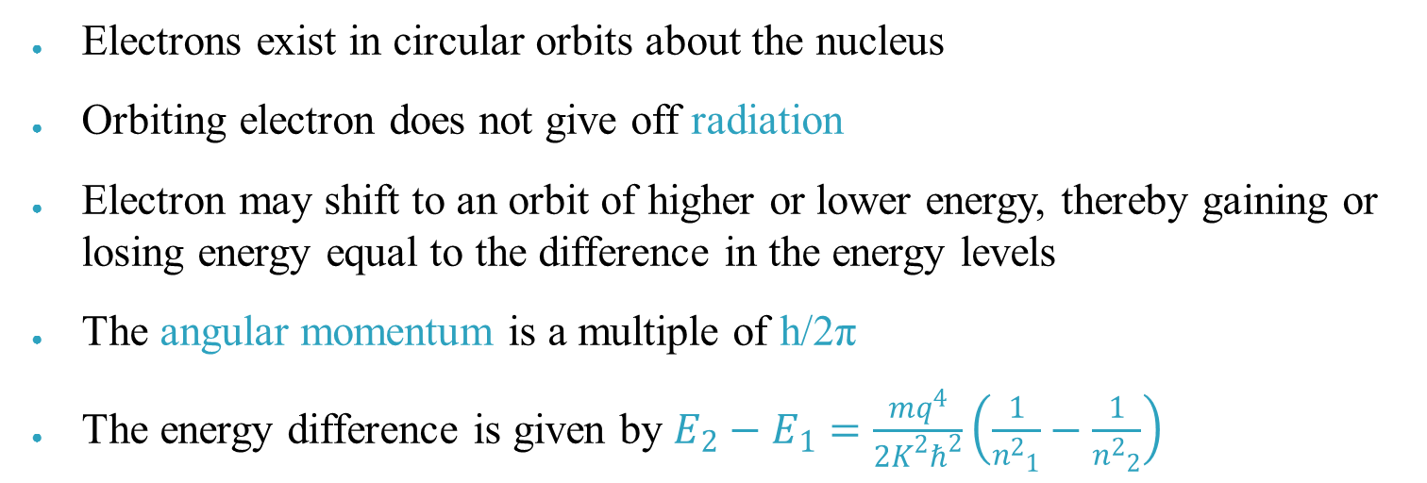
Bohr’s Model
Electrons exist in circular orbits about the nucleus
Orbiting electron does not give off radiation
Electron may shift to an orbit of higher or lower energy, thereby gaining or losing energy equal to the difference in the energy levels
The angular momentum is a multiple of h/2π
The energy difference is given by $E_{2}−E_{1}=\frac{mq^{4}}{2K^{2}ℏ^{2}}\left(\frac{1}{{n^{2}}_{1}^{}}−\frac{1}{{n^{2}}_{2}^{}}\right)$

Slide 7
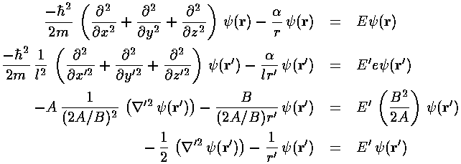
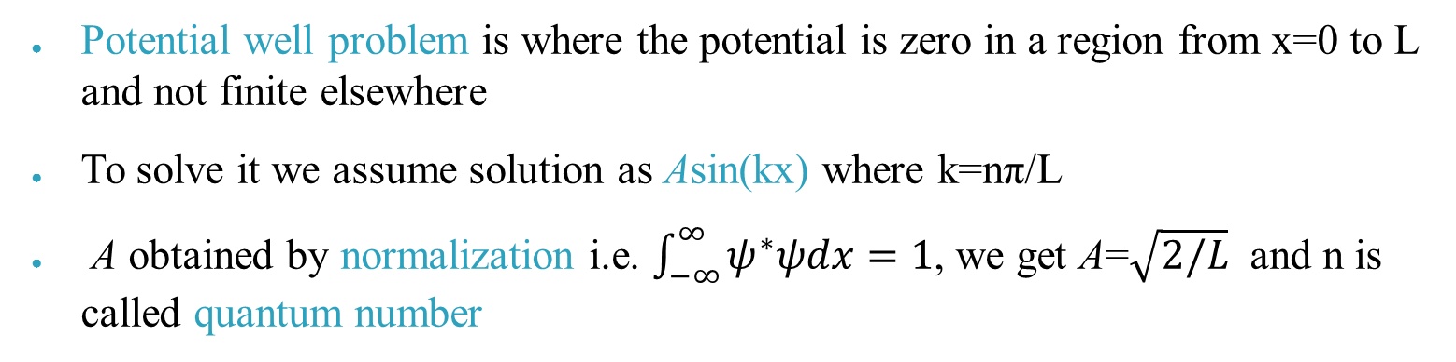
Schrödinger Equation
This is a partial differential equation that describes how the wavefunction of a physical system evolves over time.
Image source-csbsju.edu
Potential well problem is where the potential is zero in a region from x=0 to L and not finite elsewhere
To solve it we assume solution as Asin(kx) where k=nπ/L
A obtained by normalization i.e. $\int_{−∞}^{∞}{ψ^{∗}ψdx=1}$, we get A=$\sqrt{2/L}$ and n is called quantum number

Slide 8
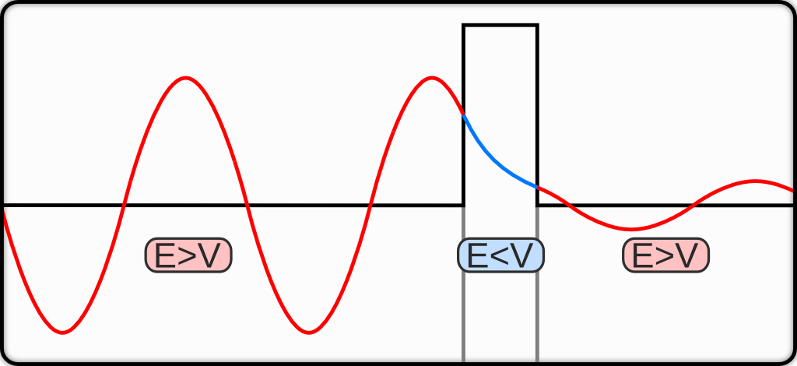
Quantum Tunnelling
Quantum tunnelling refers to the quantum mechanical phenomenon where a particle tunnels through a barrier that it classically could not surmount
In the figure the left side wave passes through the barrier which is of finite length but its amplitude is reduced
As electrons are too wave so they can cross a finite barrier
This phenomena is observed in nanoscale diodes and transistors
This could be solved by Schrödinger equation thus obtaining terms of exponentials as the solutions
Image source-wikimedia.org
Definition source-wikipedia.org

Slide 9
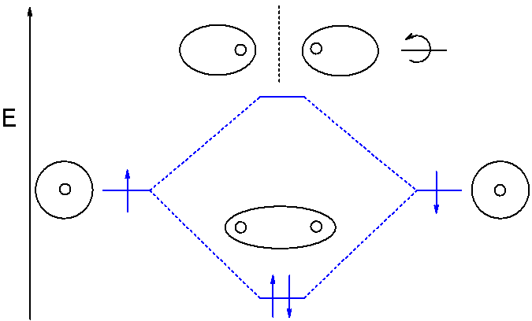
Molecular Orbital Theory
It is a method of representation and determining the structures of the molecular orbital formed when two atoms combine to form bond
The method uses LCAO(linear combination of atomic orbitals)
The atomic orbital combine to give bonding orbital(with lower energy) and antibonding orbital (with higher energy)
Antibonding Orbital
Atomic Orbitals
Bonding Orbital
Image source-wikimedia.org

Slide 10
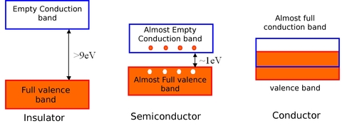
Band Theory
For conduction the electrons must reach conduction band from valence band
The energy difference between the valence band and conduction band is called band gap
Insulators have a high band gap while conductors don’t have any but semiconductors have approx~1eV

Slide 11
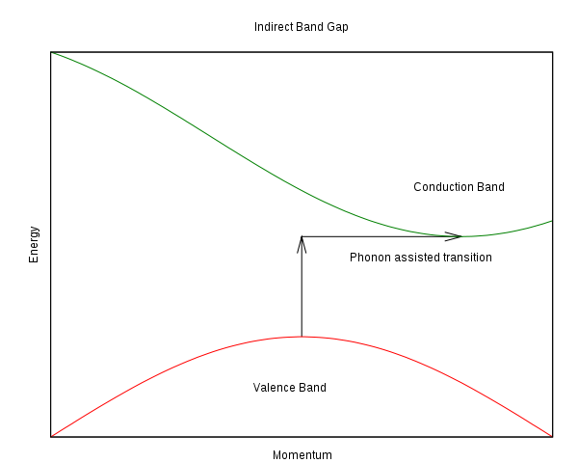
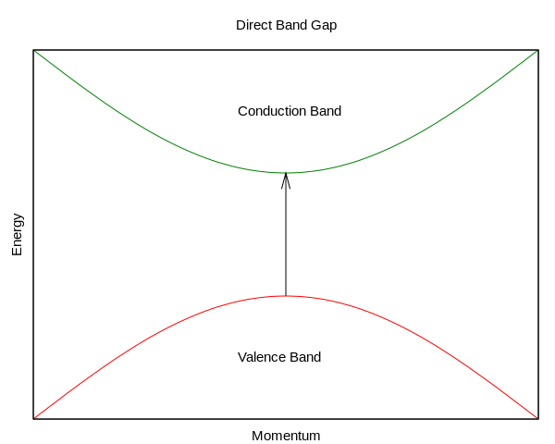
If the electron can reach the minimum energy required for conduction band from valence band without changing the momentum is called Direct Band Gap
If the electron has to change the momentum i.e. changing k(wave vector) to go to minimum energy point is called Indirect Band Gap
Direct band gap materials are used in LASERs

Slide 12
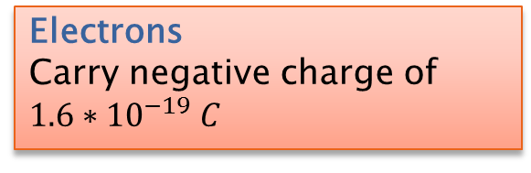
Charge Carriers
Electrons
Carry negative charge of $1.6∗{10}^{−19} C$
Holes
Carry positive charge(equal to the electronic charge)
Carrier generation and Recombination are processes by which mobile charge carriers(electrons and holes) are created and eliminated(combining to release energy)
More abundant charge is called the Majority carrier while the other is called the Minority carrier

Slide 13
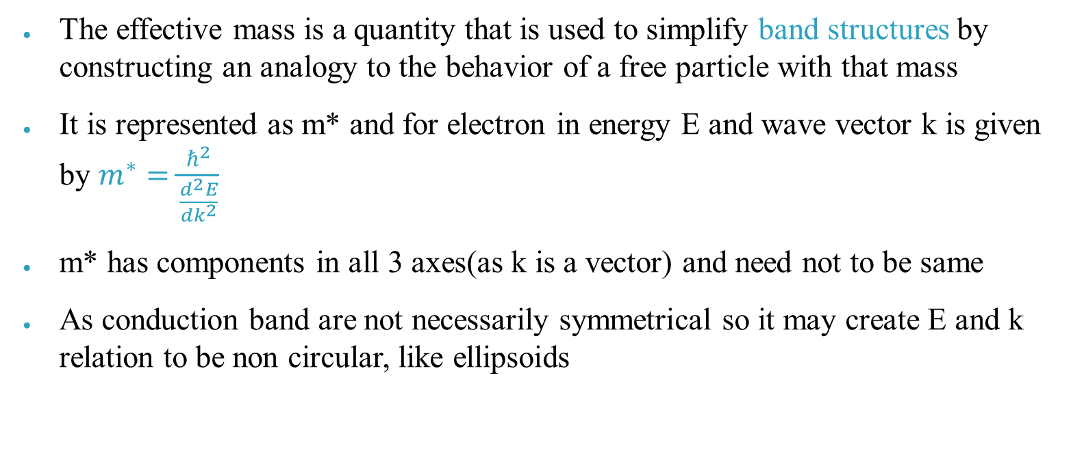
Effective Mass
The effective mass is a quantity that is used to simplify band structures by constructing an analogy to the behavior of a free particle with that mass
It is represented as m* and for electron in energy E and wave vector k is given by $m^{∗}=\frac{ℏ^{2}}{\frac{d^{2}E}{dk^{2}}}$
m* has components in all 3 axes(as k is a vector) and need not to be same
As conduction band are not necessarily symmetrical so it may create E and k relation to be non circular, like ellipsoids

Slide 14
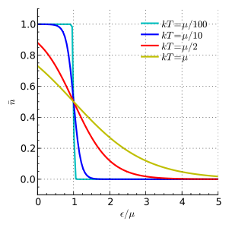
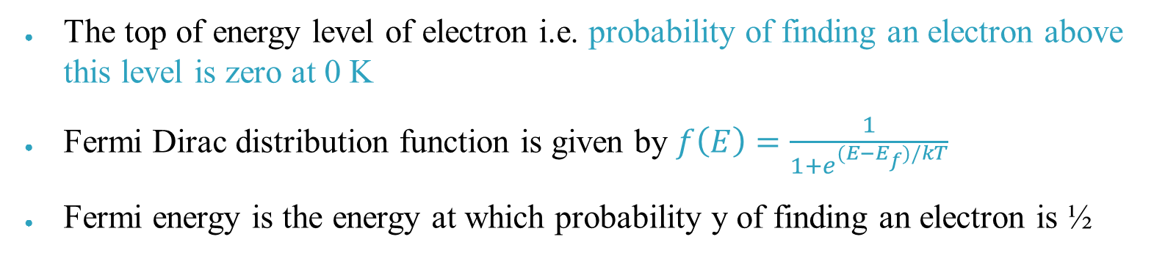
Carrier Concentration
Fermi Level
The top of energy level of electron i.e. probability of finding an electron above this level is zero at 0 K
Fermi Dirac distribution function is given by $f\left(E\right)=\frac{1}{1+e^{(E−E_{f})/kT}}$
Fermi energy is the energy at which probability y of finding an electron is ½

Slide 15
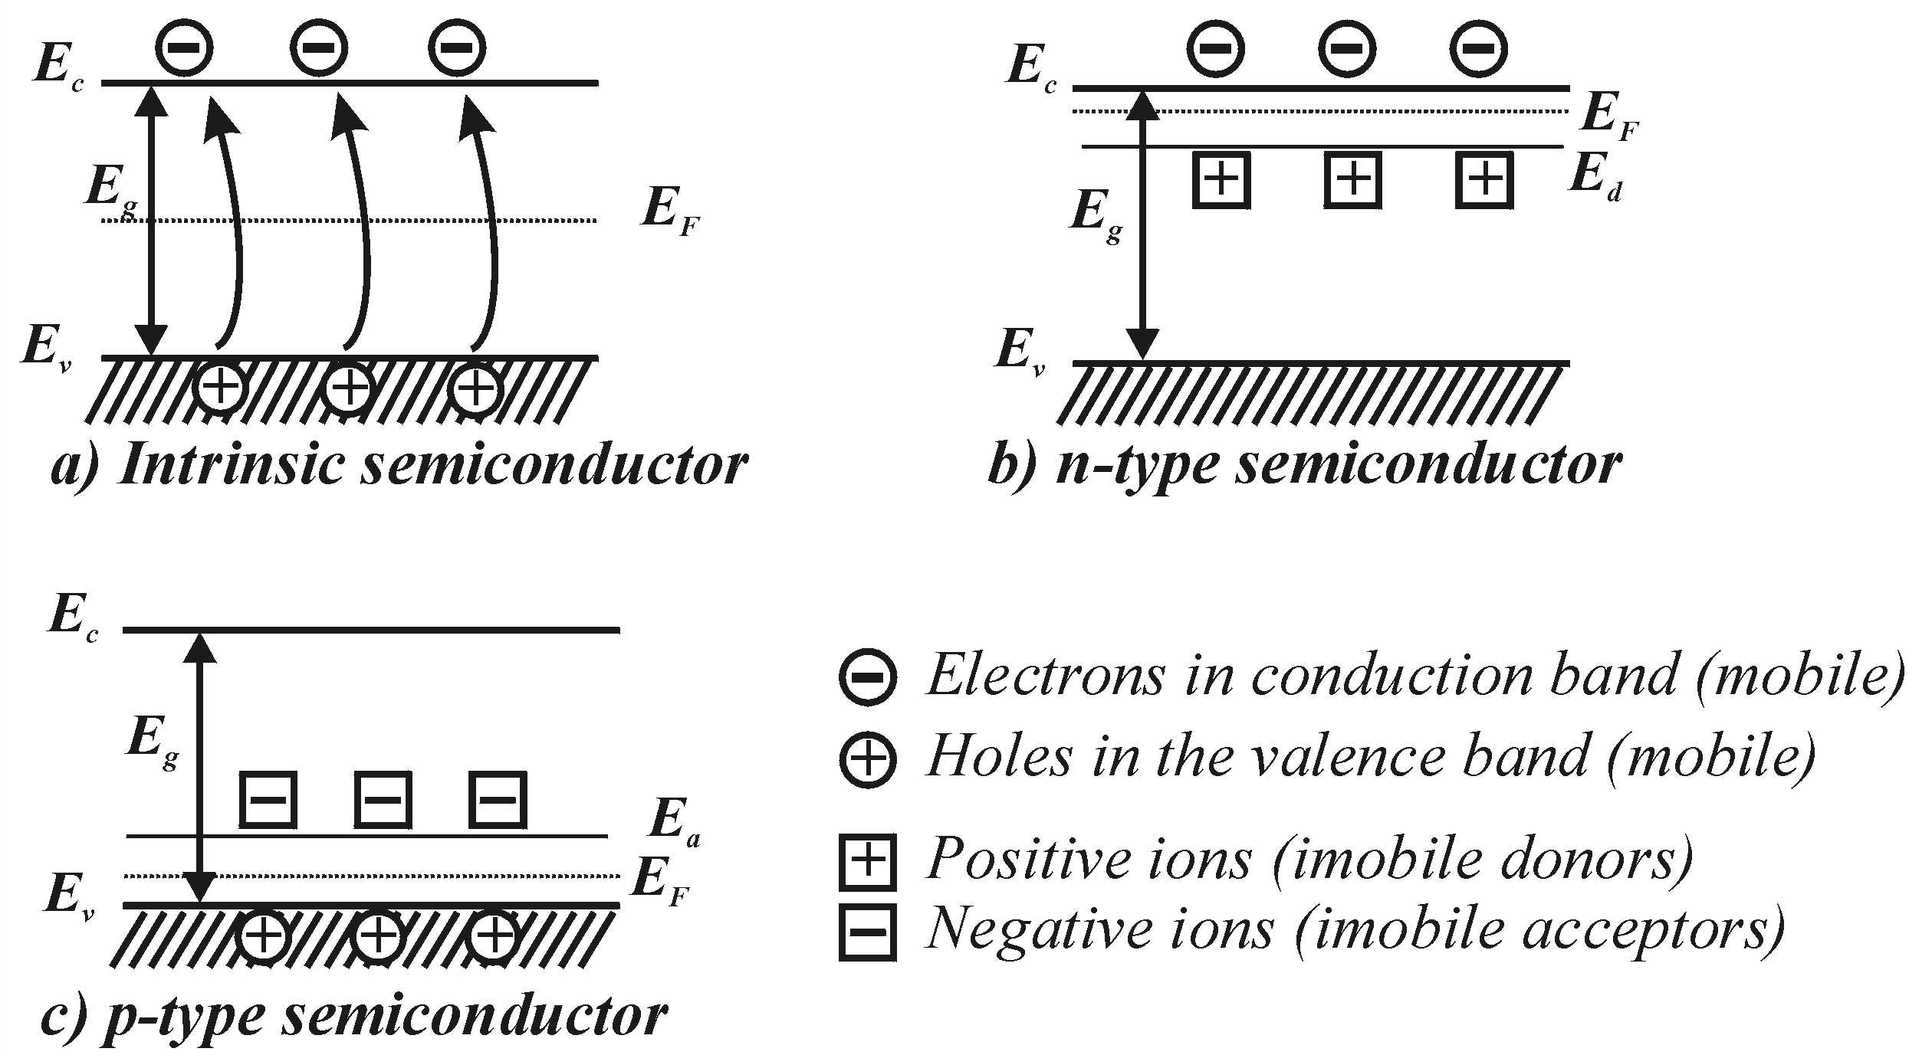
Fermi Level
Depending on the doping material the Fermi level tends to shift like for intrinsic semiconductor it is exactly in the center of the conduction and valence band
For n type it shift towards conduction as electrons are in abundance so probability actually shifts towards conduction band
On contrary for p type the shift is towards valence band or it could be said that probability of holes =1-probability of electrons at particular energy so holes show similar pattern as electrons show in n type semiconductor

Slide 16
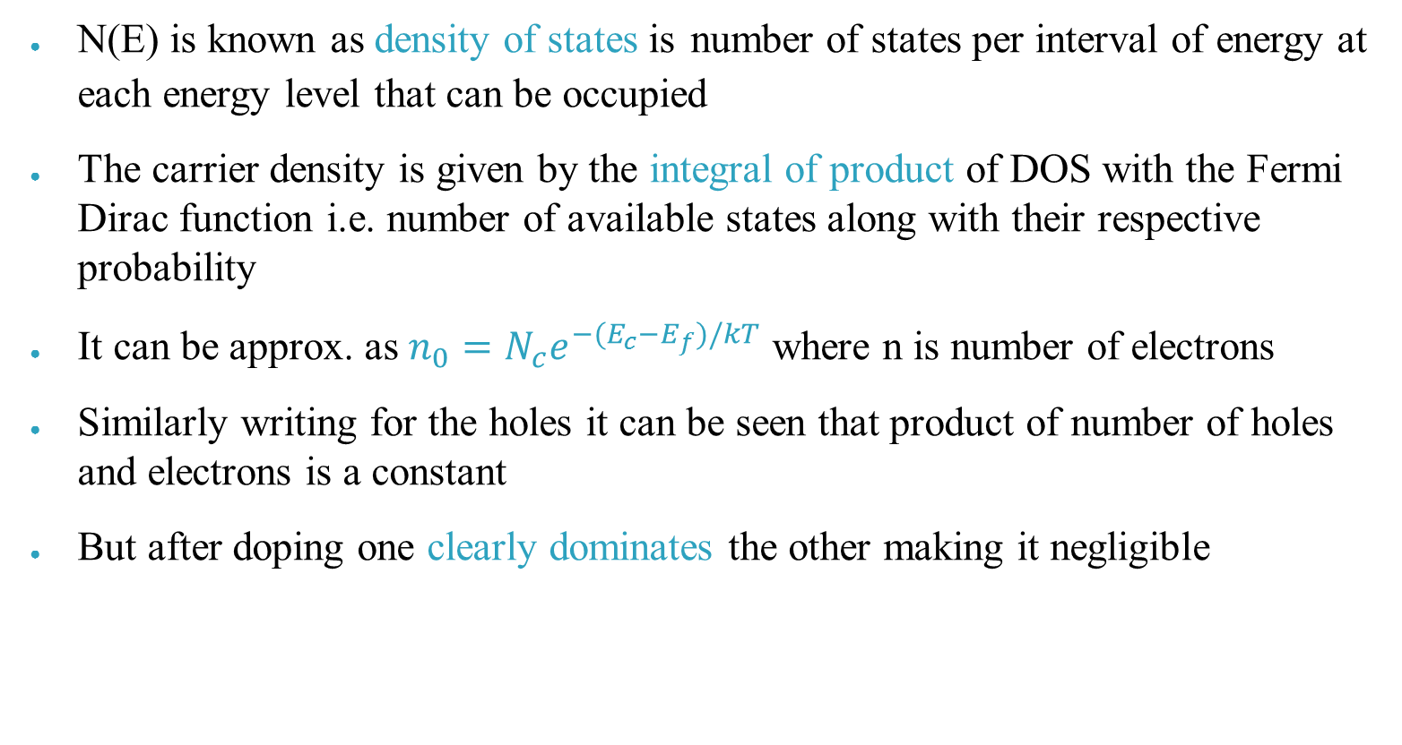
Carrier Concentration
N(E) is known as density of states is number of states per interval of energy at each energy level that can be occupied
The carrier density is given by the integral of product of DOS with the Fermi Dirac function i.e. number of available states along with their respective probability
It can be approx. as $n_{0}=N_{c}e^{−(E_{c}−E_{f})/kT}$ where n is number of electrons
Similarly writing for the holes it can be seen that product of number of holes and electrons is a constant
But after doping one clearly dominates the other making it negligible

Slide 17
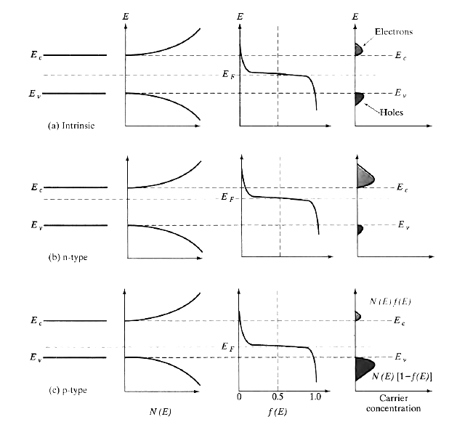
Image source-Solid states electronic devices 6th edition

Slide 18
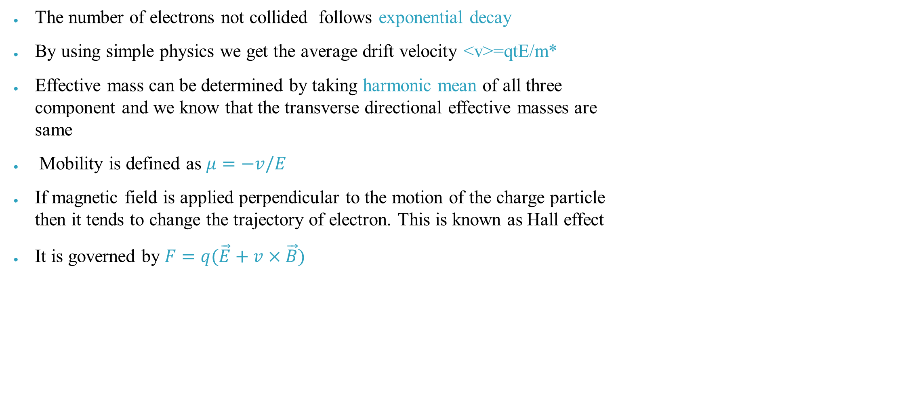
Conductivity and mobility
The number of electrons not collided follows exponential decay
By using simple physics we get the average drift velocity <v>=qtE/m*
Effective mass can be determined by taking harmonic mean of all three component and we know that the transverse directional effective masses are same
Mobility is defined as $μ=−v/E$
If magnetic field is applied perpendicular to the motion of the charge particle then it tends to change the trajectory of electron. This is known as Hall effect
It is governed by $F=q(\vec{E}+v×\vec{B})$

Slide 19
THANK YOU

